Slide 1



Basic Details of the Team and Problem Statement
Ministry: Department of School Education & Literacy (DOSEL), Ministry of Education.
PS Code: RK786
Problem Statement Title: Monitoring safety in schools by the school, students, teachers, and parents, with the escalation of issues to District and state level with the help of an App masking the identity of the person who escalates the issue.
Team Name: Codureka
Team Leader Name: Abhishek Kumar
Institute Code (AISHE):C-45308
Institute Name: Jyothy Institute of Technology
Theme Name: Safety and Security

Slide 2
Idea /Approach Details
This app accepts complaints from students, parents, and teachers.
The users can voice their concerns by posting their complaints.
Users can vote for a complaint posted if they face the same issue.
If an issue has a lot of votes then it gets escalated to the district level authorities.
Users can post their complaints anonymously to maintain secrecy.

Slide 3
Use Case
Faculty can request for changes in the system by raising a complaint for change.
Major issues can be brought to the attention of the district and state level authorities through the app.
For parents to voice their concerns about their ward as well as financial and educational concerns regarding their ward’s school.
For students to raise issues about any difficulties they experience in school.
Technology Stack
Flutter 2.10
Android Studio 2021.1.1
Firebase API

Slide 4
Objectives
To co-create a safe and secure school environment for the holistic development of children.
To create a platform for different stockholders to participate in supporting and raising issues regarding safety and security aspects in school environment.
To emphasize the “Zero Tolerance Policy” against any negligence on the part of any individual or management when it comes to the safety and security of children in schools.

Slide 5

What is SWAP?
Students Welfare Application Portal (SWAP) is a mobile application designed for raising issues that is faced in schools and to support the existing complaints through voting.
SWAP uses the power of cloud computing to provide unique experience using Firebase DB .

Slide 6
Raise an issue anonymously. | Direct involvement of a Administrator, Students, Parents and Teachers.
Portal is user-friendly and based on cloud computing with Firebase Platform. | All records are updated instantly .
Why SWAP?

Slide 7

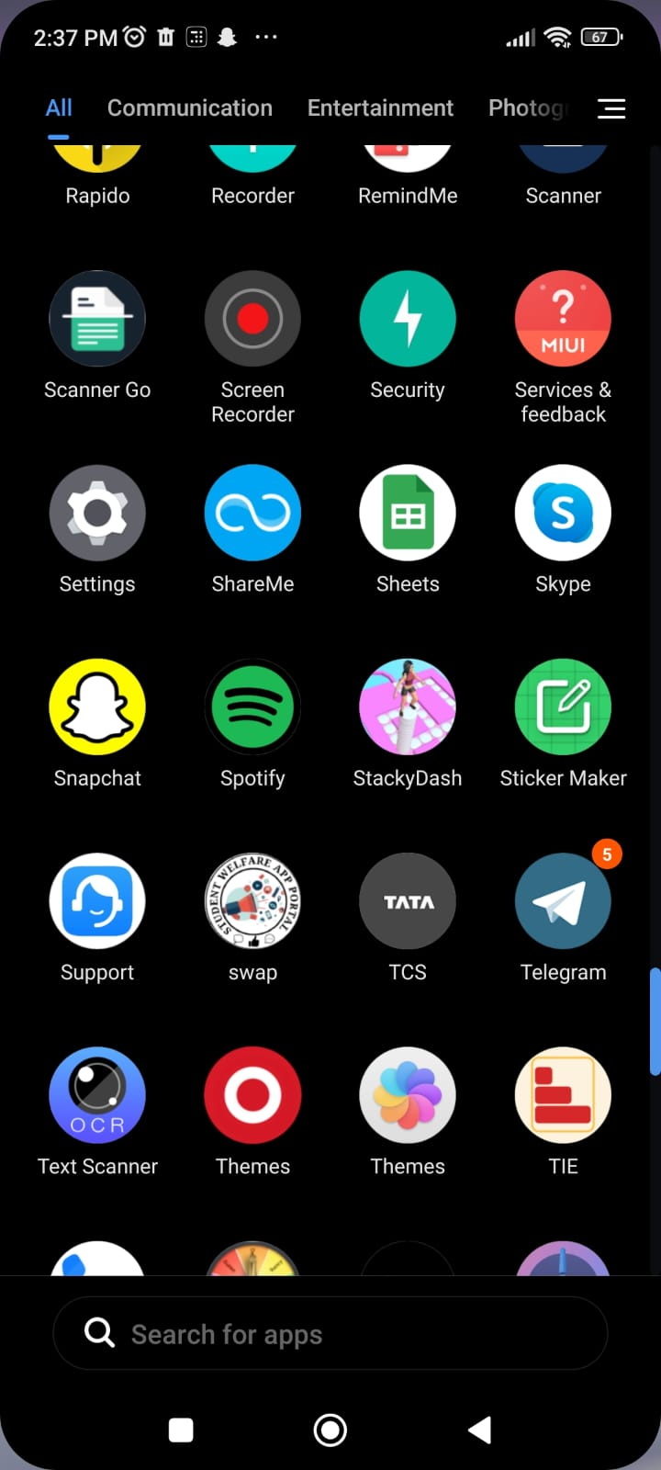
Results and Snapshots

Slide 8
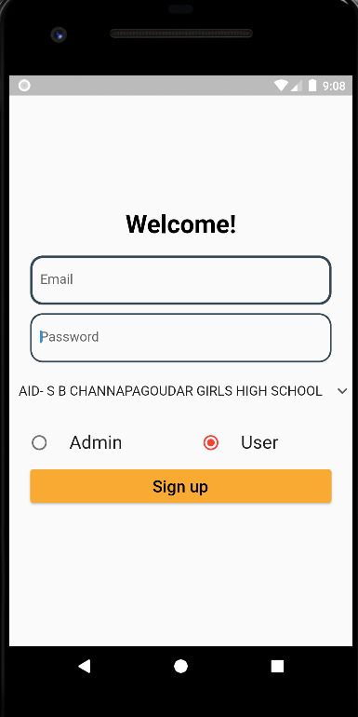
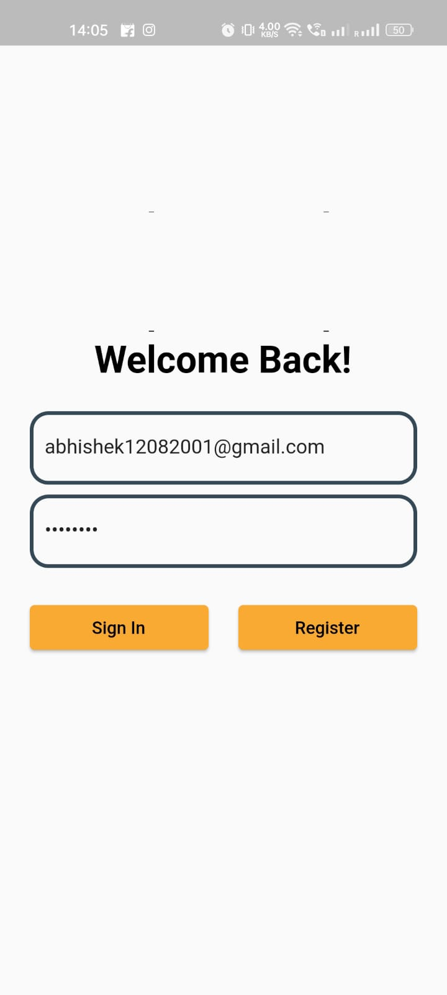
Results and Snapshots
Registration and Login

Slide 9
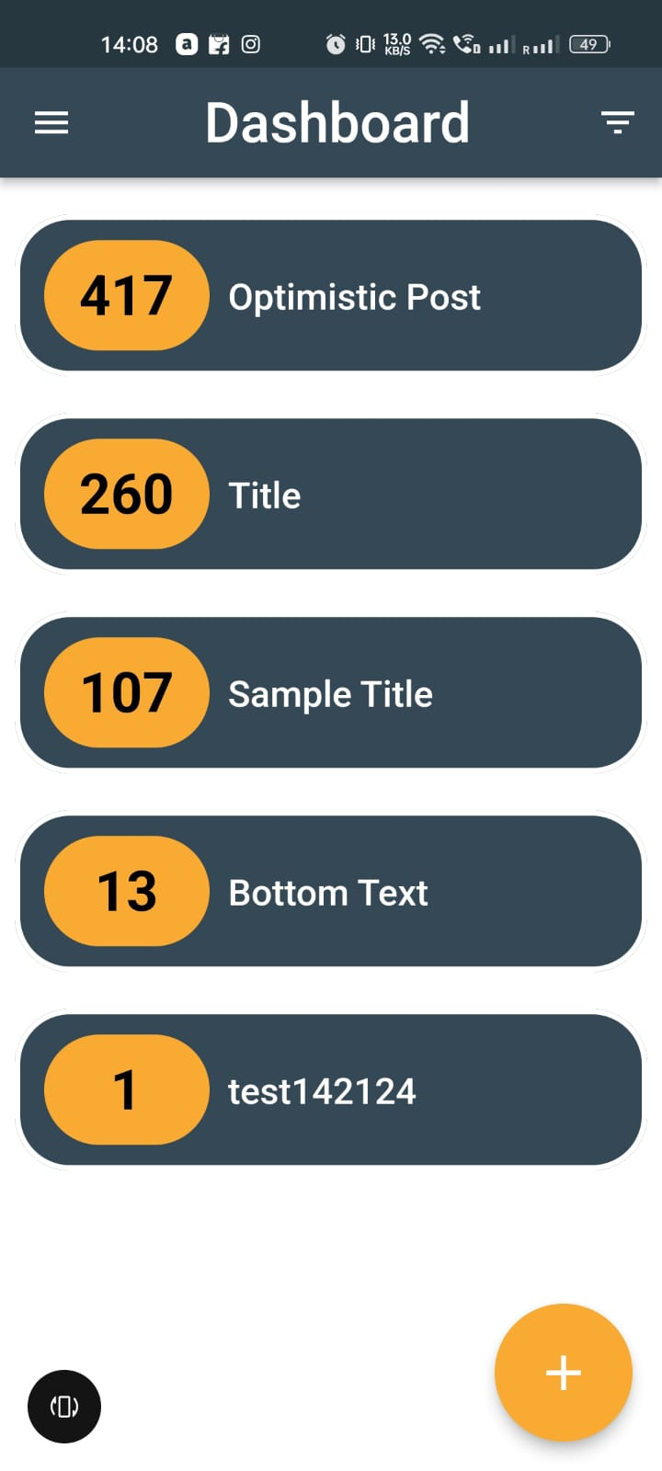
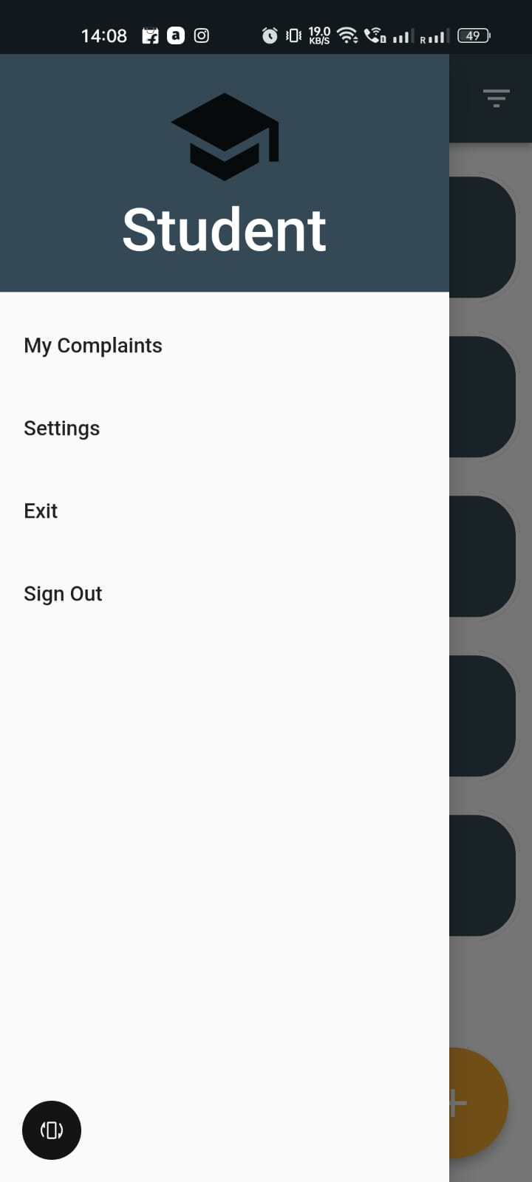
Results and Snapshots

Slide 10
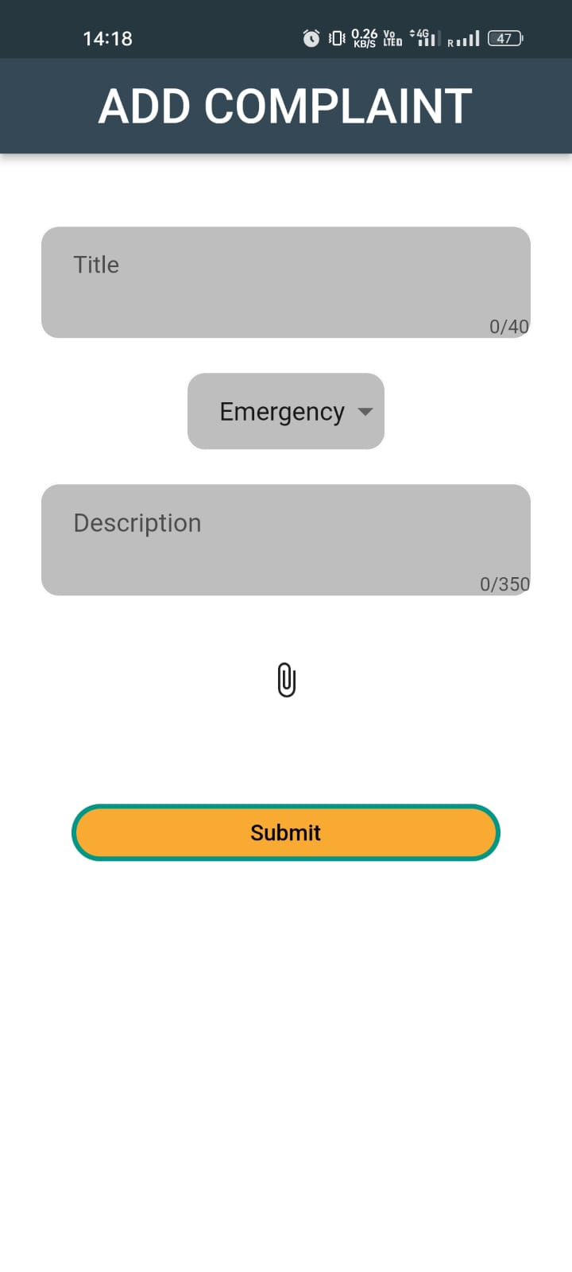
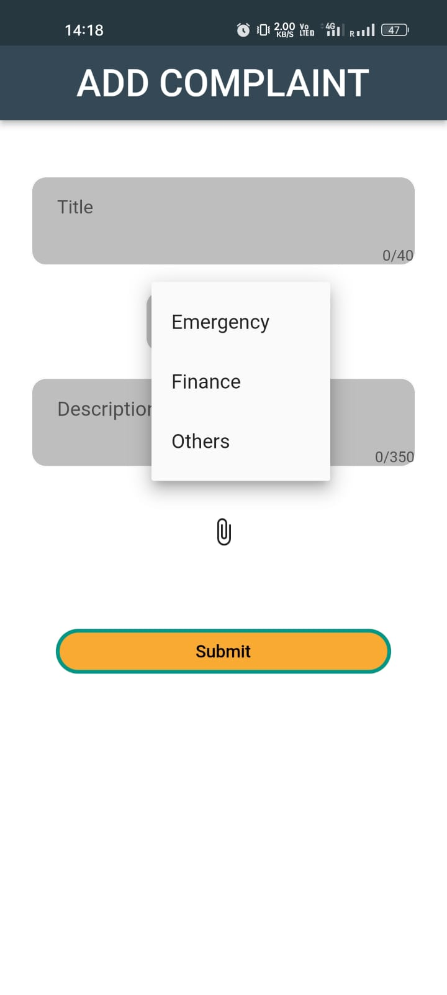
Results and Snapshots

Slide 11
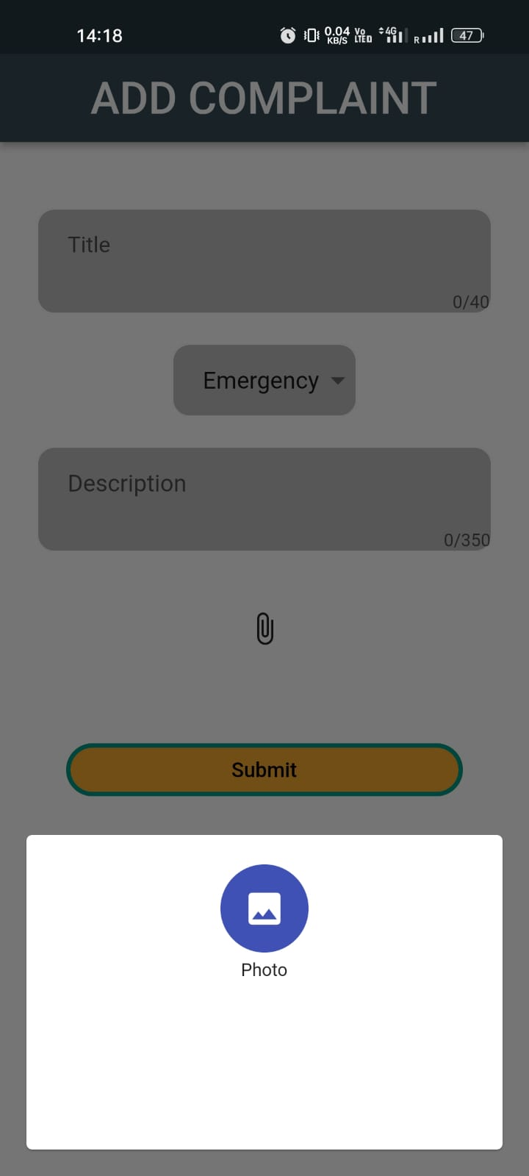
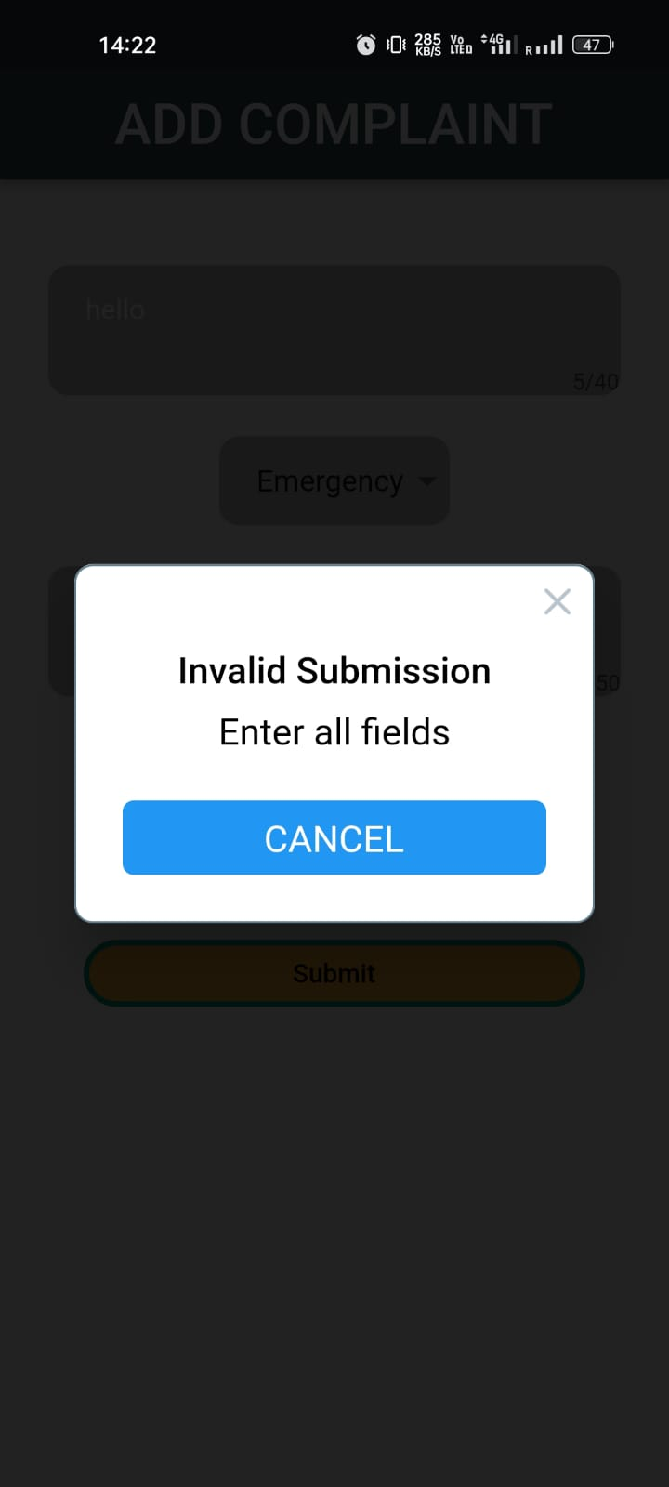
Results and Snapshots

Slide 12
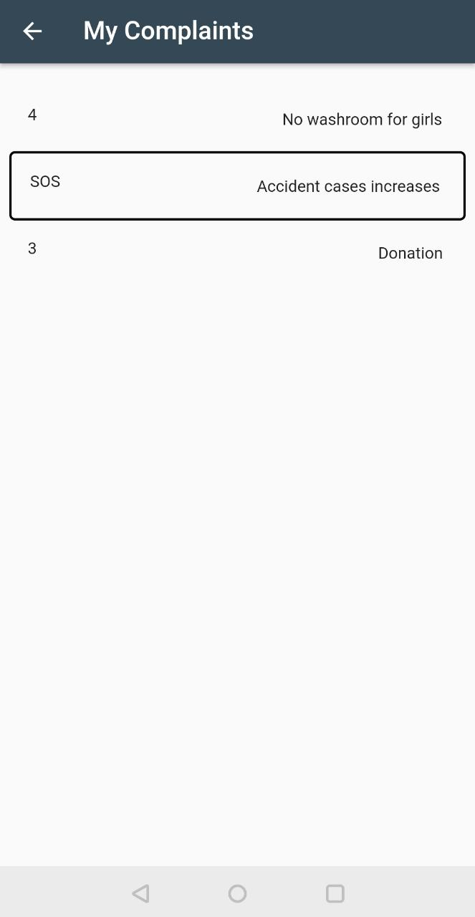
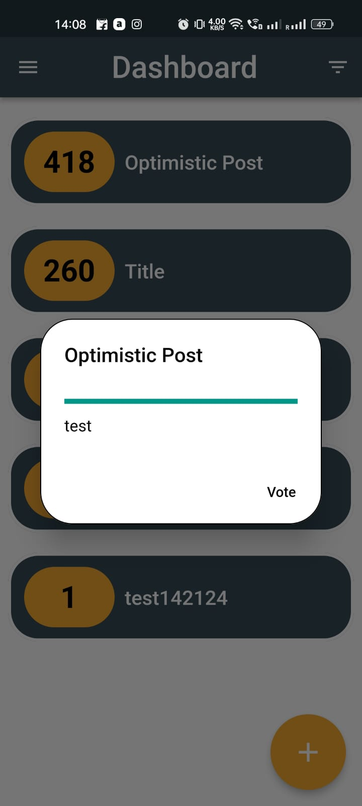
Results and Snapshots

Slide 13
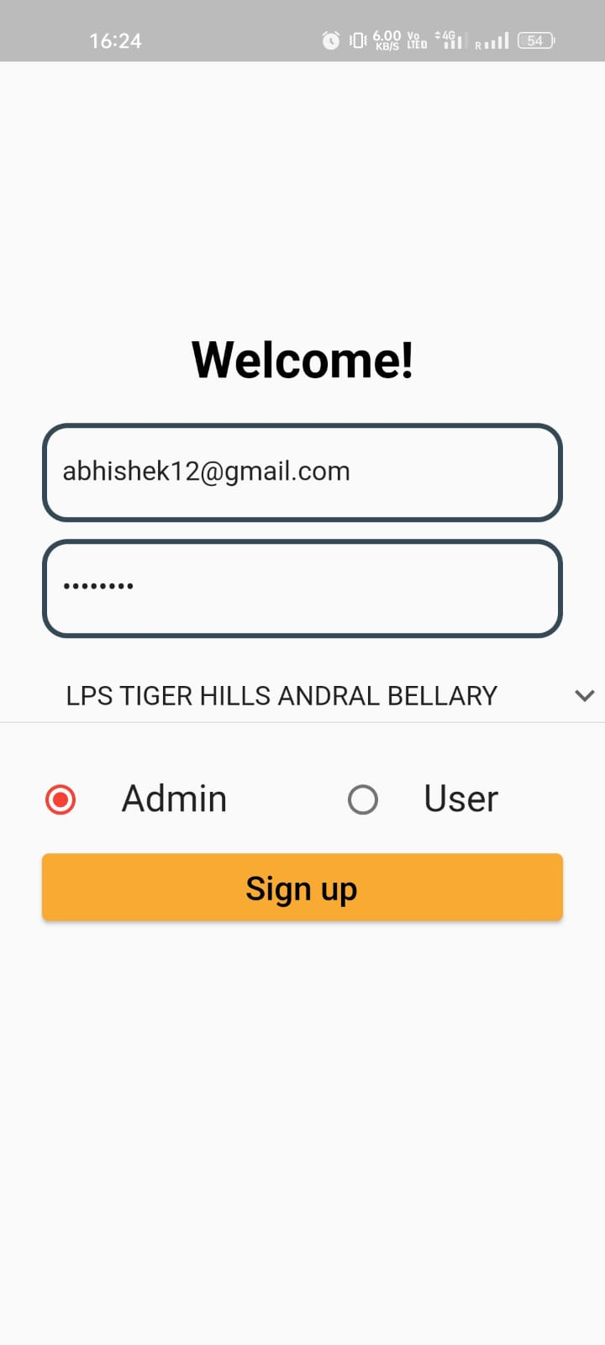
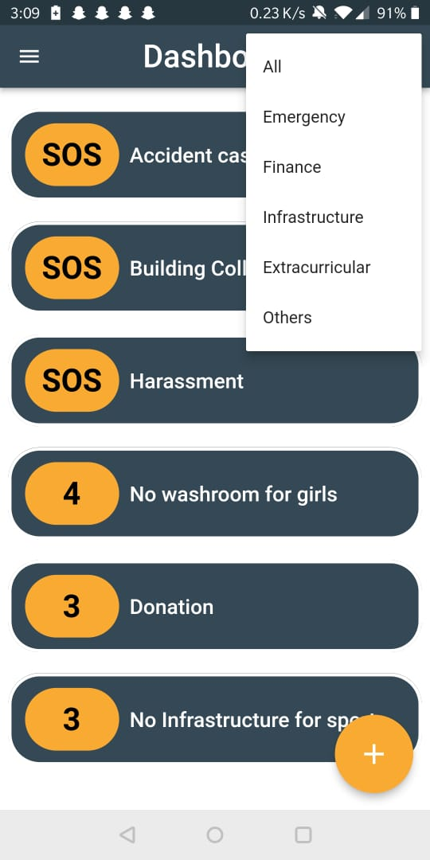
Results and Snapshots
Admin Login and Dashboard

Slide 14
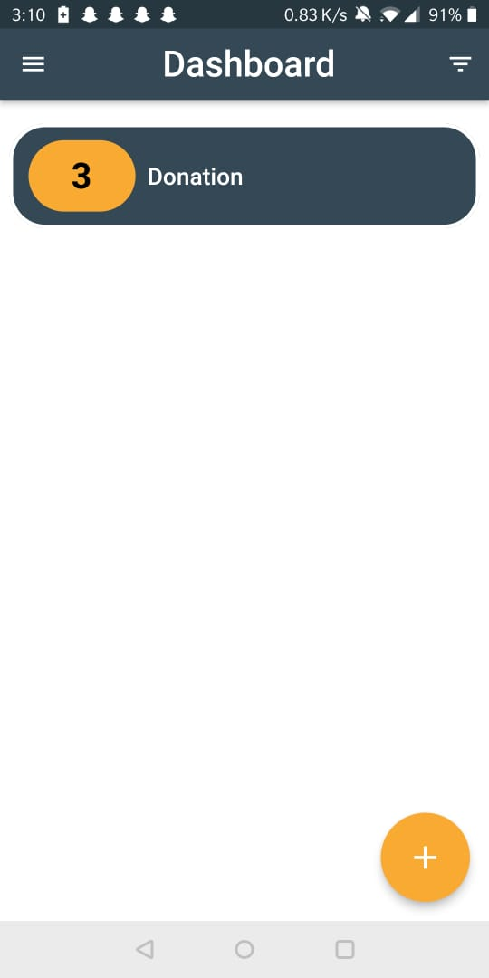
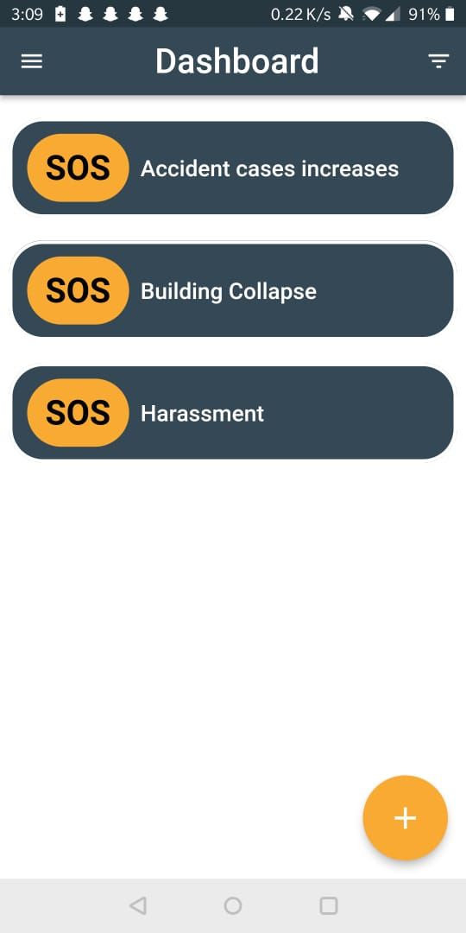
Results and Snapshots

Slide 15
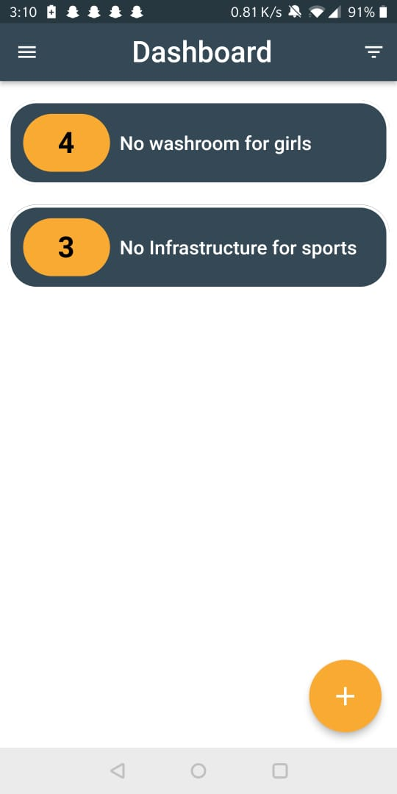
Results and Snapshots

Slide 16
Team Member Details
Team Leader Name: Abhishek Kumar
Branch: BE Stream: CSE Year:2019
Team Member 1 Name: Aditya Krishnan
Branch: BE Stream: CSE Year:2019
Team Member 2 Name: Ajin Sumesh
Branch: BE Stream: CSE Year:2019
Team Member 3 Name: Harsh Soni
Branch: BE Stream: CSE Year:2019
Team Member 4 Name: Amrutha S
Branch: BE Stream: CSE Year:2019
Team Member 5 Name: Ibtisam Pinjar
Branch: BE Stream: CSE Year:2019
Team Mentor Name: Saravana M K
Category: Academics Expertise: Neural Networks and Fuzzy Logic Experience: 8years

